Slide 1

Library Management System
MPP Group 2
Issa Fikadu
Ashraf Elsayed
Pat Adrian Limosnero

Slide 2
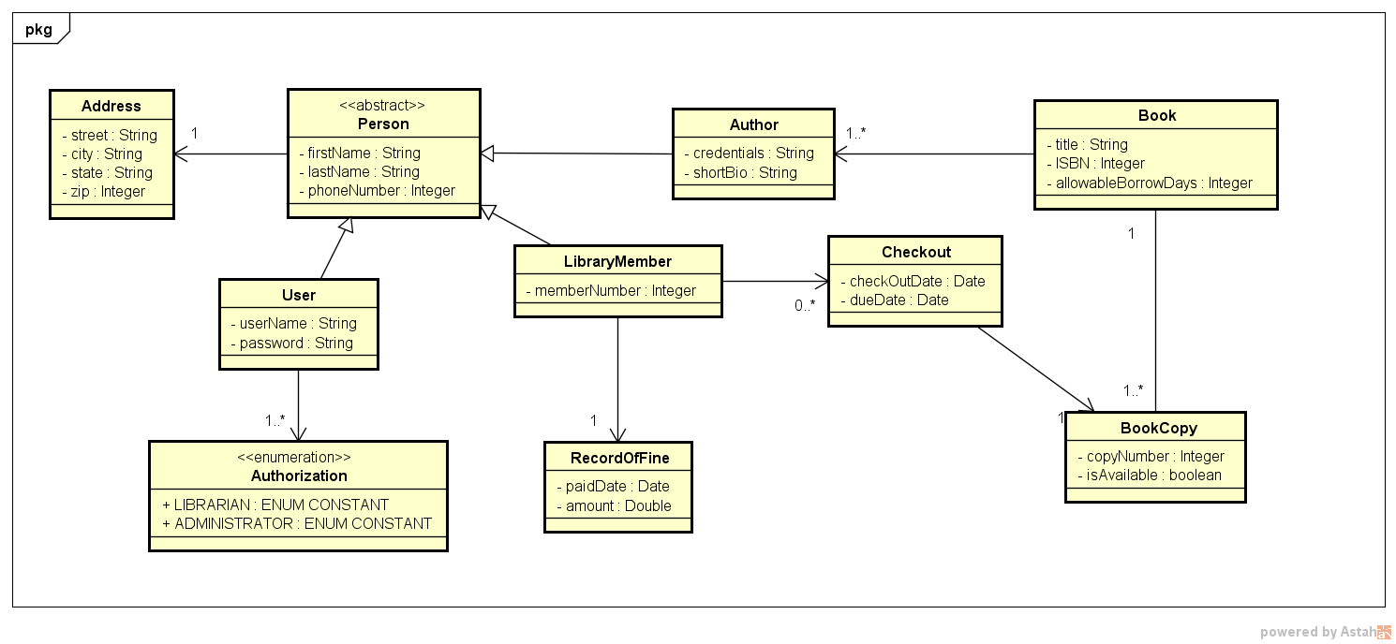
Class Diagram

Slide 3
Features
Add New Library Member
Edit Library Member
Add Book
Add Book Copy
Add Author
Check out Book
Check In Book

Slide 4
Data Files
storage\user.bin
storage\book.bin
storage\library_members.bin

Slide 5
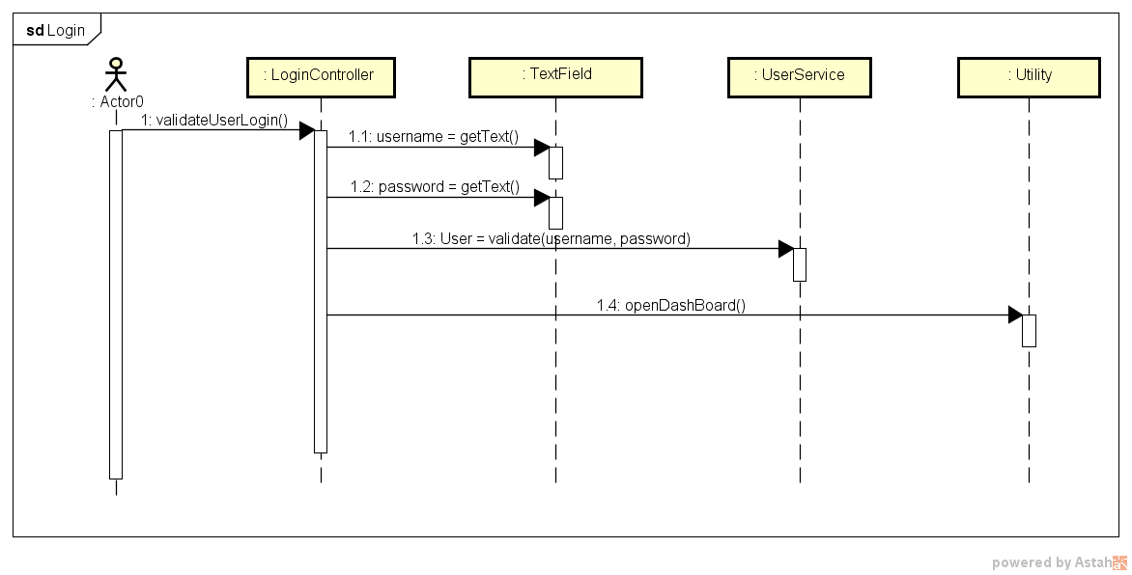
Sequence Diagram - Login

Slide 6
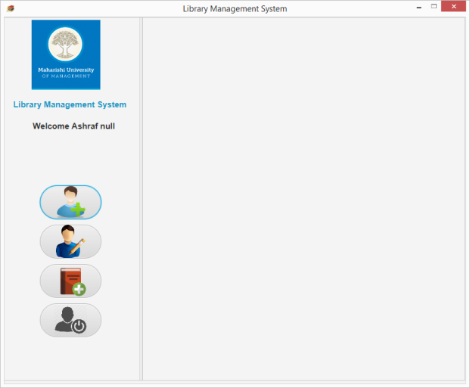
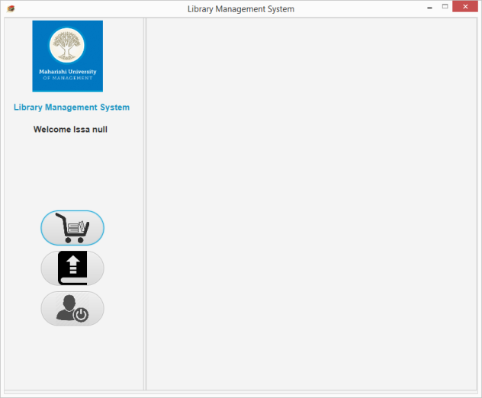
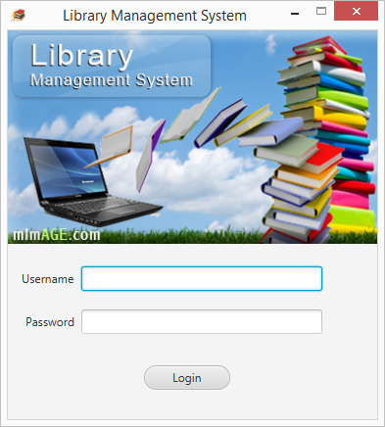
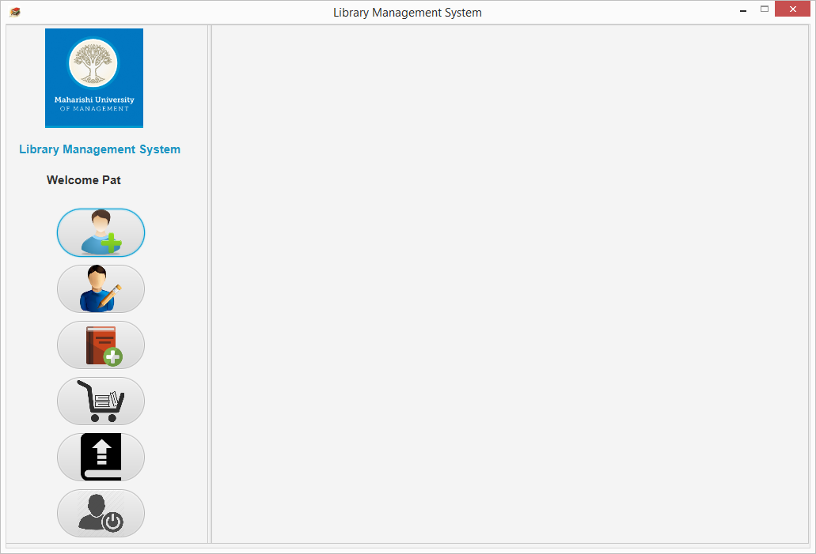
Screen Shot - Login

Slide 7
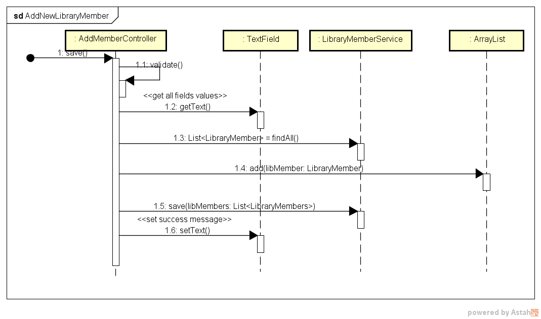
Sequence Diagram – Add New Library Member

Slide 8
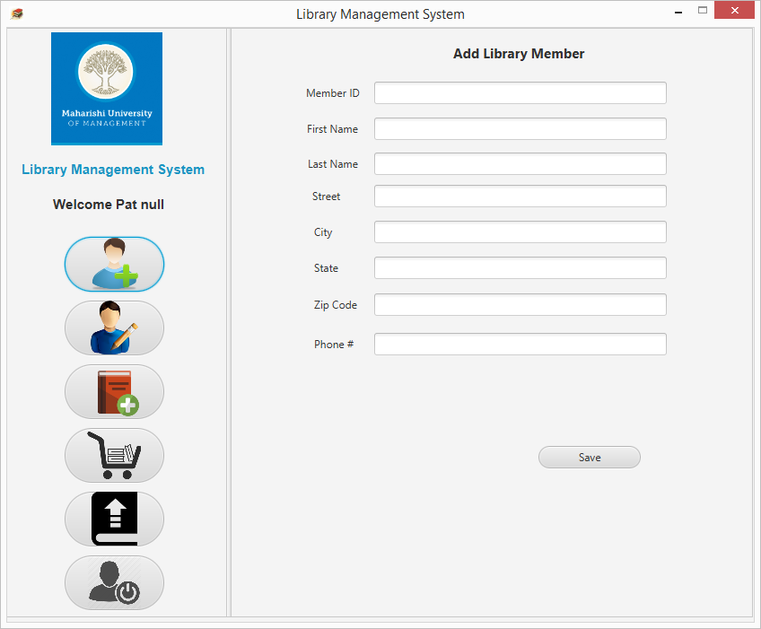
Screen Shot – Add New Library Member

Slide 9
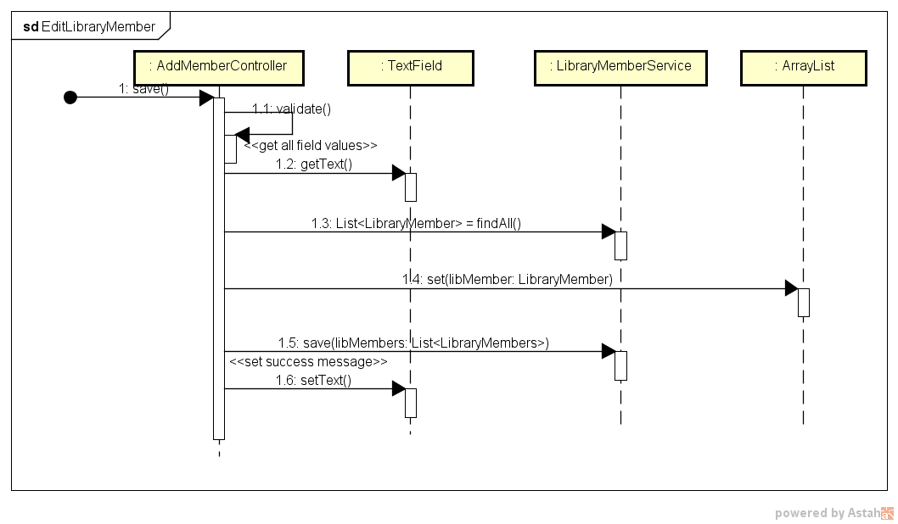
Sequence Diagram – Edit New Library Member

Slide 10
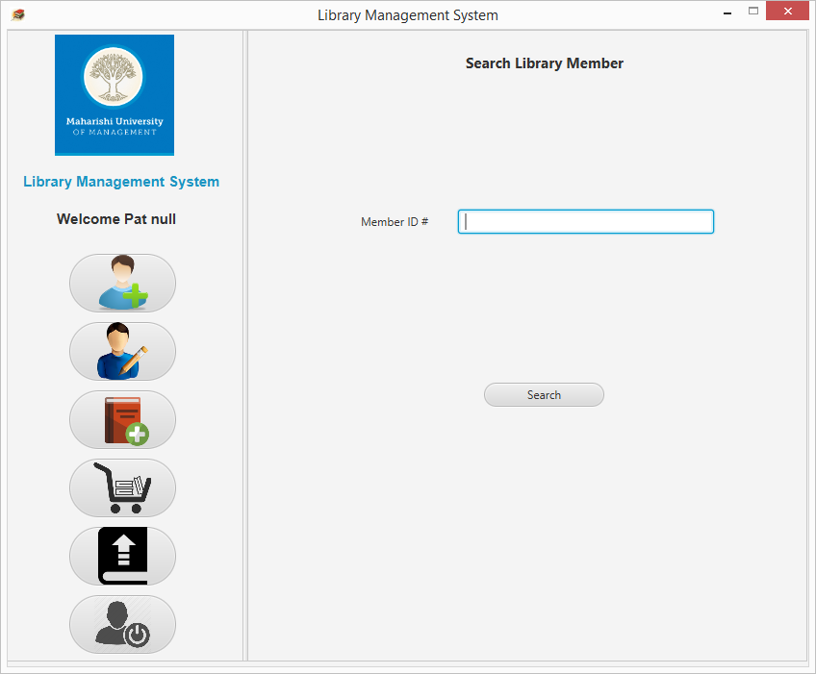

Screen Shot – Edit Library Member Information

Slide 11
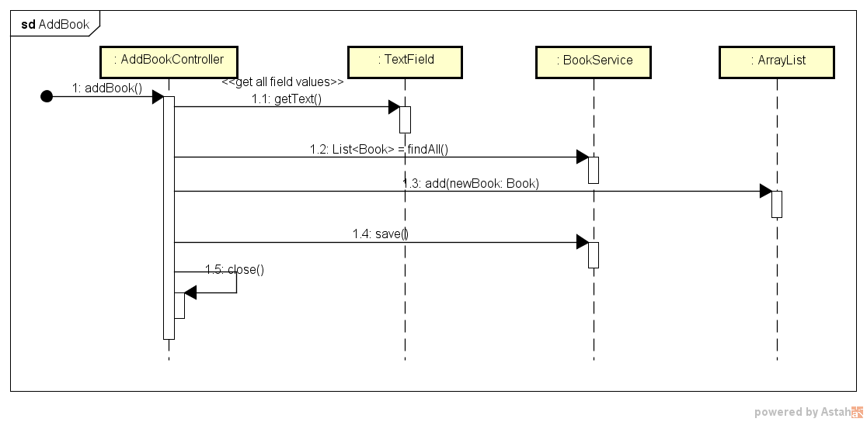
Sequence Diagram – Add Book

Slide 12
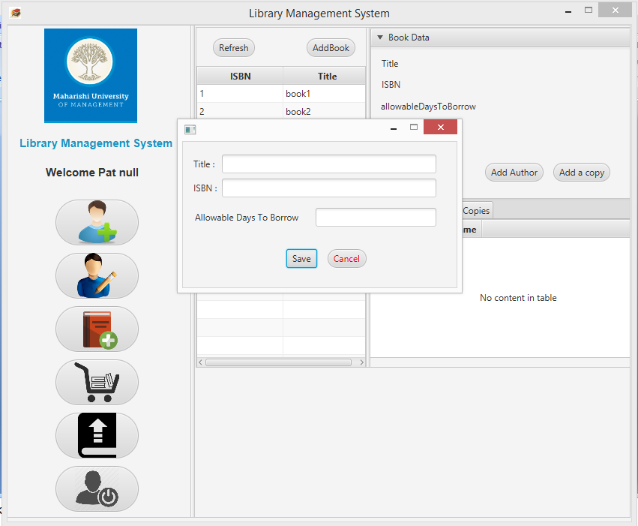
Screen Shot – Add Book

Slide 13
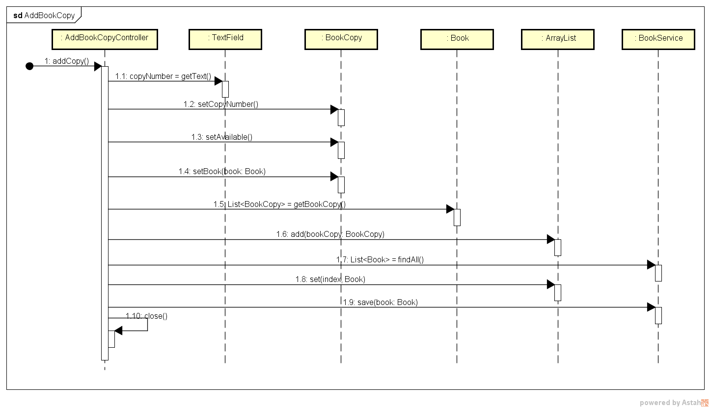
Sequence Diagram – Add Book Copy

Slide 14
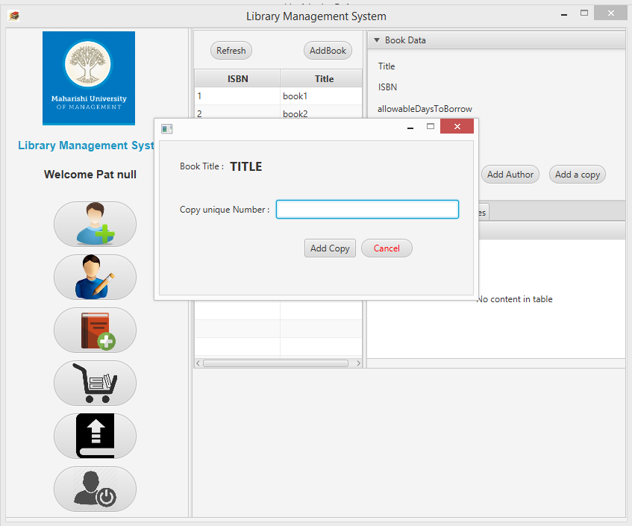
Screen Shot – Add Book Copy

Slide 15
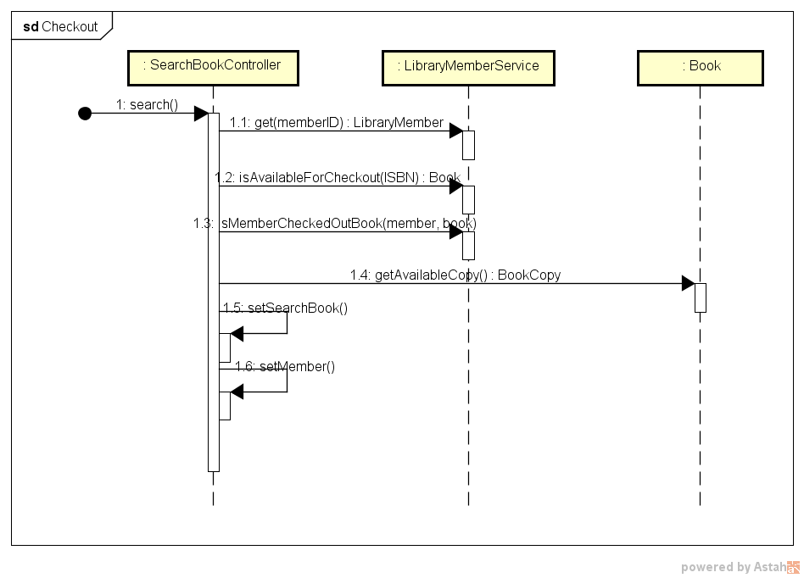
Sequence Diagram – Check Out Book

Slide 16
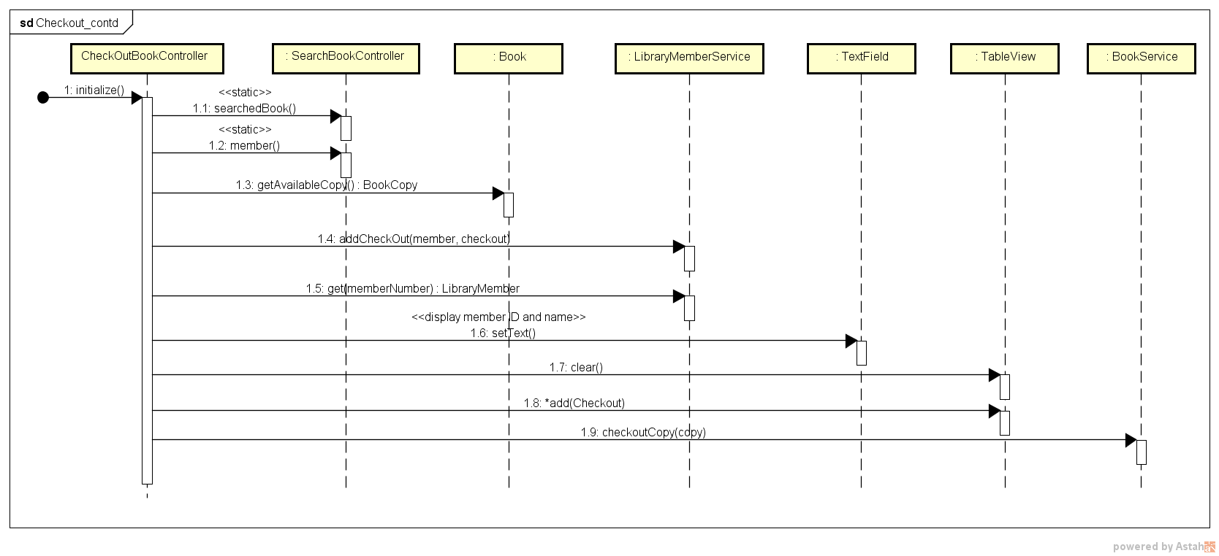
Sequence Diagram – Check Out Book (contd..)

Slide 17
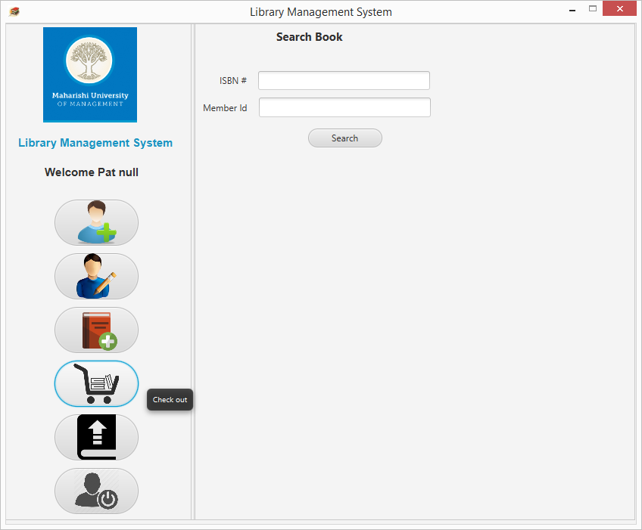
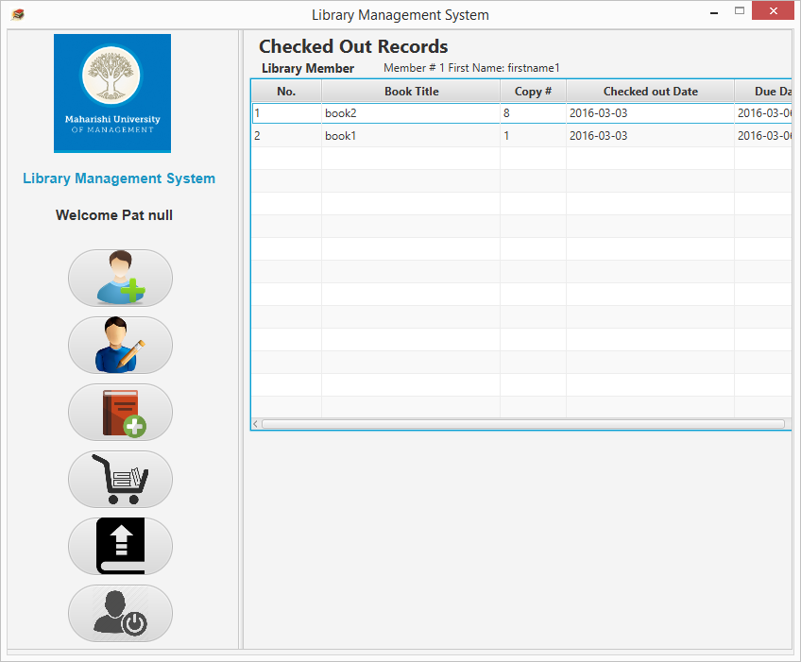
Screen Shot – Check Out Book

Slide 18
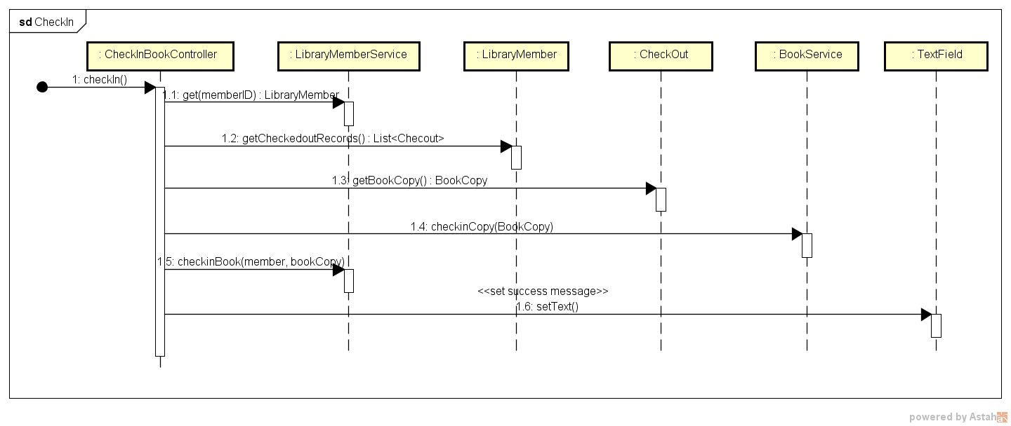
Sequence Diagram – Check In Book

Slide 19
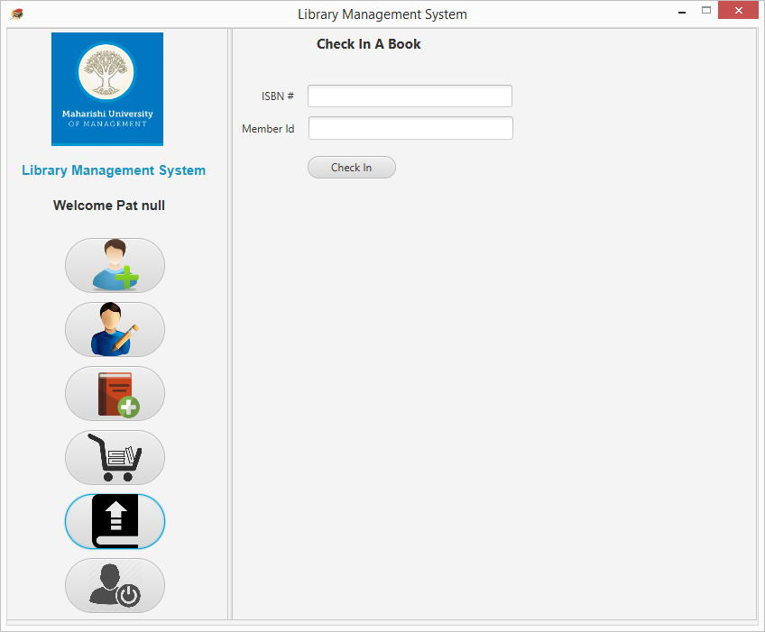
Screen Shot – Check In Book

Slide 20


Slide 21


